Slide 1







Azure Landing Zones IaC Accelerator
Accelerator Components
Phases
Documentation
0 Planning
aka.ms/alz/acc
User Guide
Comprehensive Phase-by-phase and Step-by-step instructions
Platform Landing Zone
Detailed documentation
Bootstrap
Choose the bootstrap configuration
Platform Landing Zone
Choose the Scenario and Options
Configuration Files
1 Pre-requisites
Bootstrap Configuration File
YAML for bootstrap preferences
Platform Landing Zone Configuration File
TFVARS (HCL) for detailed Platform landing zone configuration
Identities
Setup bootstrap accounts for Azure and and Version Control System
Subscriptions
Prepare Identity, Management and Connectivity subscriptions
ALZ PowerShell Module
Orchestrates the Bootstrap
2 Bootstrap
Automated Bootstrap
GitHub or Azure DevOps
Repos, CI / CD, Environments, Approvals, Variables, Agents etc…
Azure
IAM, State Management, Agent Compute, etc…
Bootstrap Modules
GitHub
Azure DevOps
File System
3 Run
Starter Modules
Deploy
Run the Pipeline / Action to deploy the landing zone
Iterate
Update your module for specific needs / updates and re-run the pipeline
Bicep
Terraform

Slide 2
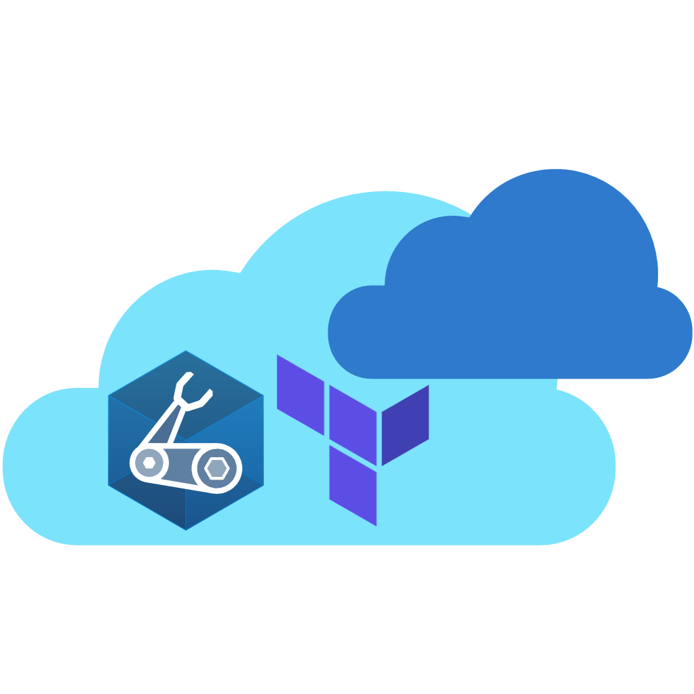
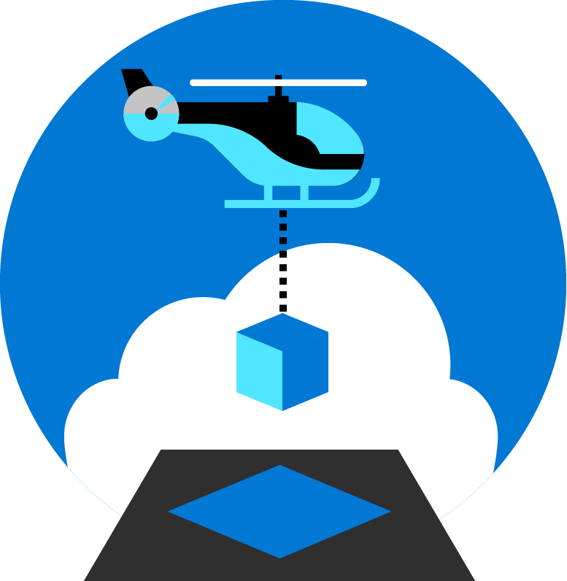

Azure Landing Zones
Azure Verified Modules

Slide 3



Slide 4








Microsoft Azure
Version Control System
Identity
Repository
Service Connections
Branch policy
Plan
Apply
Permissions applied for ALZ module
Starter module files and variables
Plan
User Assigned Managed Identities for Plan and Apply with Federated Credentials
Environments
Apply
State
Plan
Apply
Approvals
Approvals
Concurrency control
Concurrency control
Group / Team
Agent Pool / Runner Group
Storage Account and Container
Approvers
Agent 1
Agents / Runners
Pipelines / Actions
Private Networking
Agent 2
CI
CD
- apply
- destroy
Container Registry
Variable Set / Repository Variables
Container Instances Running Agents

Slide 5
Azure Landing Zones Accelerators
Accelerator Components
Phases
Docs and Bootstrap
1 Pre-requisites
Documentation
Phase-by-phase and Step-by-step instructions
Create the pre-requisites
Elevated Account
SP or user account with management group and subscription owner permissions
Subscriptions
Identity, Management and Connectivity
PowerShell Module
(Deploy-Accelerator)
2 Bootstrap
Bootstrap Modules
Automated Bootstrap
GitHub or Azure DevOps
Repos, CI / CD, Environments, Approvals, Variables, Agents etc…
Azure
IAM, State Management, Agent Compute, etc…
GitHub
Azure DevOps
Local File System
3 Run
Starter Modules
Deploy
Run the Pipeline / Action to deploy the landing zone
Iterate
Update your module for specific needs / updates and re-run the pipeline
Bicep
Terraform

